Slide 1
Project Management in Real Estate Industry With online booking
MUHAMMAD SHUHAIR VK
MES20MCA-2033
PRODUCT OWNER: MR MUHAMMAD JABIR

Slide 2
TABLE OF CONTENTS
Introduction
Modules
Data Flow Diagram
Table Design
Developing Environment
Product Backlog
User Stories
Project Plan
Sprint Plans
Sprint Actual

Slide 3
INTRODUCTION
Project Management is a methodology originally developed for the construction industry for controlling schedules, costs, and specifications. Over a period of time, it was discovered that the same techniques tweaked a little actually apply to all industries starting from manufacturing to the high technology operations. Project management is an art of setting up all the components of a project together to work in sync. A logical approach to bind the various components together with effective planning improves the chances for a successfully delivered project. A real estate project differs from any other domain in terms of the number of different components it involves.
The complexity of these components if not dealt with maturity with a persistent approach may lead to disastrous results for the project. Though there are various ways of cost estimation for real estate projects, the unit cost for the bill of quantities works best. The easiest way to estimate is to break down the project into tasks. Once tasks are defined and resources are assessed with their respective quantities are mapped, it is then time to assign unit costs. The total cost is then determined by summing up the costs incurred in each task. The various types of costs linked to any resource can be in terms of man, material, labor and expenses (overheads). In a real estate project, construction cost is only a fraction of the total cost of the project. These include design costs, bid costs, approval costs and control costs

Slide 4
MODULES
ADMIN
View User reviews
Accept / Reject Broker
Block / Unblock Broker
Send reply to complaints
View Suggestions
View Rating
BROKER
Registration
Add plot details
View Booking
Enquiries
Chat with User
Add Complaints

Slide 5
USER
Book Plot
View Plot
Chat with Broker
Send Complaint
Send Suggestions
Add Rating

Slide 6
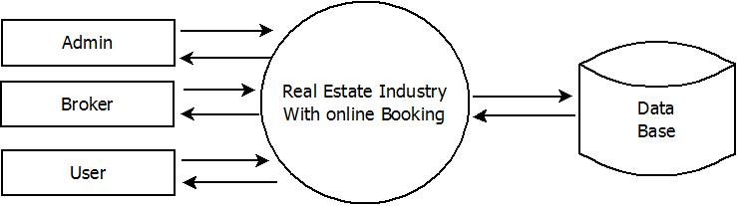
DATA FLOW DIAGRAM
LEVEL 0

Slide 7
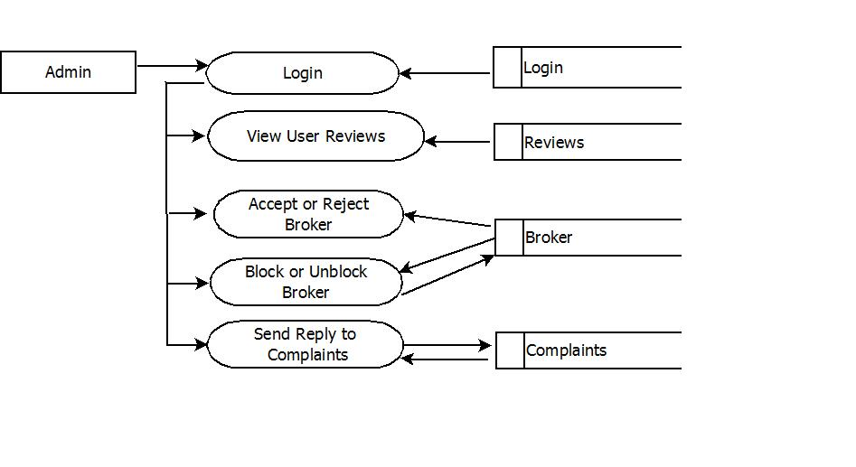
LEVEL 1.1

Slide 8
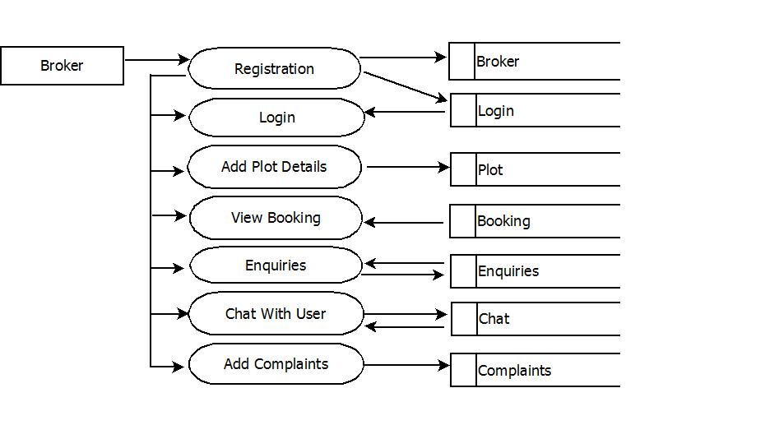
LEVEL 1.2

Slide 9
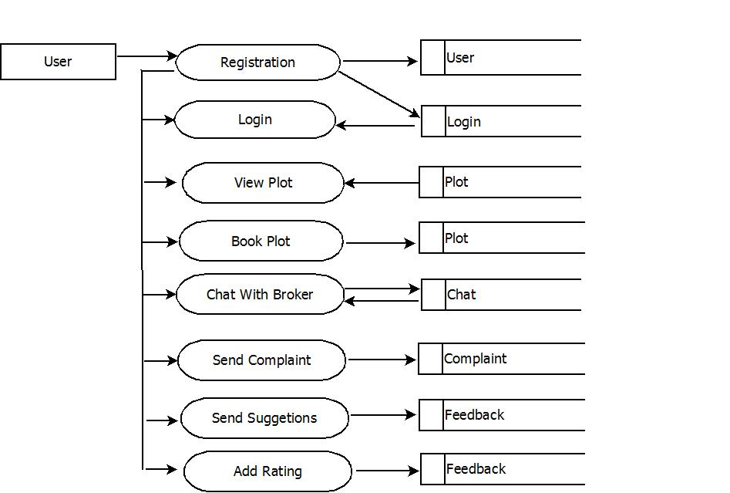
LEVEL 1.3

Slide 10
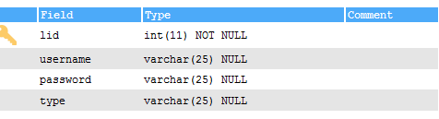
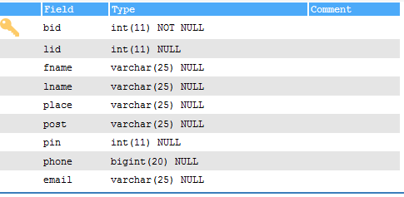
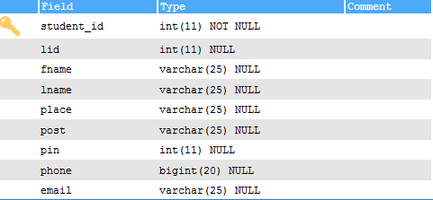
TABLE DESIGN
login
broker_reg
user_reg

Slide 11
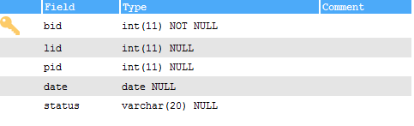
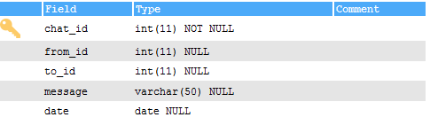
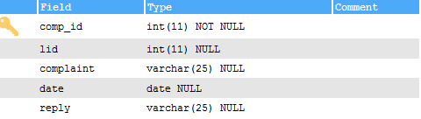
booking
chat
complaints

Slide 12
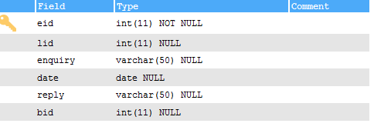
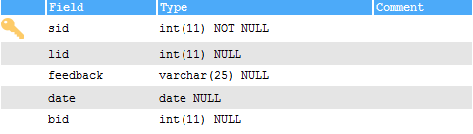
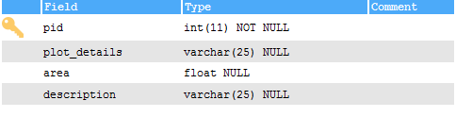
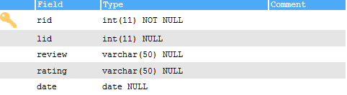
enquiries
feedback
Plot
review

Slide 13
DEVELOPING ENVIRONMENT
Operating System - Windows 7 or Above, Android
Technology - Python, Java
Backend - MySQL
Platform used - PyCharm, Android Studio
Web Browser - Google Chrome, Fire fox, Microsoft Edge
Front End - HTML, CSS, JAVASCRIPT
Frame work - Flask

Slide 14
USER STORIES
UserStoryID | As a <type of user> | I want to | So that I can
1 | Admin | login | login successful with correct username and password
2 | Admin | view user reviews | view reviews added by user
3 | Admin | Accept or reject broker | Accept or reject broker
4 | Admin | Block or unblock broker | Block or unblock broker
5 | Admin | Send reply to complaints | View complaints and reply to user
6 | Broker | Registration and login | Login successful with correct username and password
7 | Broker | Add plot details | Users can view plots
8 | Broker | View booking | View booking added by user
9 | Broker | Enquiries | View enquiries added by user

Slide 15
 | Broker | Chat with user | Interact with users
 | Broker | Add complaints | Add complaints about users
 | User | Registration and login | Login successful with correct username and password
 | User | View plots | View plots added by broker
 | User | Book plots | Book plots added by broker
 | User | Chat with broker | Interact with broker
 | User | Send complaints | Send complaints
 | User | Send suggestions | Send suggetions
 | User | Add rating | Add rating about plots added by broker

Slide 16
PRODUCT BACKLOG
User Story ID | Priority <High/Medium/Low> | Size (Hours) | Sprint <#> | Status <Planned/In progress/Completed> | Release Date | Release Goal
1 | Medium | 2 | 1 | Completed |  | Table design
2 | High | 3 |  | Completed |  | Form design
3 | High | 5 |  | Completed |  | Basic coding
4 | High | 5 | 2 | Planned |  | Property management
5 | Medium | 5 |  | Planned |  | Enquiries
6 | High | 5 | 3 | Planned |  | Online booking
7 | Medium | 5 |  | Planned |  | Chat
8 | Medium | 5 | 4 | Planned |  | Testing data
9 | High | 5 |  | Planned |  | Output generation

Slide 17
PROJECT PLAN
User Story ID | Task Name | Start Date | End Date | Days | Status
1 | Sprint 1 | 26/12/2021 | 28/12/2021 | 2 | Completed
2 |  | 29/12/2021 | 31/12/2021 | 3 | Completed
3 |  | 03/12/2021 | 08/01/2022 | 5 | Completed
4 | Sprint 2 | 09/01/2022 | 16/01/2022 | 8 | Planned
5 |  | 18/01/2022 | 22/01/2022 | 5 | Planned
6 | Sprint 3 | 23/01/2022 | 27/01/2022 | 5 | Planned
7 |  | 30/01/2022 | 05/02/2022 | 7 | Planned
8 | Sprint 4 | 07/02/2022 | 10/01/2022 | 4 | Planned
9 |  | 17/02/2022 | 20/02/2022 | 4 | Planned

Slide 18
SPRINT BACKLOG PLAN
Backlog Item | Status & completion date | Original estimate in hours | Day1 | Day2 | Day3 | Day4 | Day5 | Day6 | Day7 | Day8 | Day9 | Day10 | Day11 | Day12 | Day13 | Day14
User story #1,#2,#3,#4 |  | hrs | hrs | hrs | hrs | hrs | hrs | hrs | hrs | hrs | hrs | hrs | hrs | hrs | hrs | hrs
Table design | 28/12/2021 | 2 | 1 | 1 | 0 | 0 | 0 | 0 | 0 | 0 | 0 | 0 | 0 | 0 | 0 | 0
Form design | 31/12/2021 | 3 | 0 | 0 | 0 | 1 | 1 | 1 | 0 | 0 | 0 | 0 | 0 | 0 | 0 | 0
Basic Coding | 08/01/2021 | 5 | 0 | 0 | 0 | 0 | 0 | 0 | 0 | 0 | 0 | 1 | 1 | 1 | 1 | 1
User story #5,#6,#7,#8
Property Managements | 16/01/2022 | 5 | 1 | 1 | 0 | 1 | 0 | 1 | 0 | 1 | 0 | 0 | 0 | 0 | 0 | 0
Enquiries | 22/01/2022 | 5 | 0 | 0 | 0 | 0 | 0 | 0 | 0 | 0 | 0 | 1 | 1 | 1 | 1 | 1
Online booking | 27/01/2022 | 5 | 1 | 1 | 1 | 1 | 1 | 0 | 0 | 0 | 0 | 0 | 0 | 0 | 0 | 0
Chat | 05/02/2022 | 5 | 0 | 0 | 0 | 0 | 0 | 0 | 0 | 1 | 0 | 1 | 1 | 1 | 0 | 1
Testing data | 10/01/2022 | 5 | 1 | 1 | 1 | 1 | 1 | 0 | 0 | 0 | 0 | 0 | 0 | 0 | 0 | 0
User story #9
Output generation | 20/02/2022 | 5 | 0 | 0 | 0 | 0 | 0 | 0 | 0 | 0 | 0 | 2 | 1 | 1 | 1 | 1
Total |  | 40 | 4 | 4 | 2 | 4 | 3 | 2 | 0 | 2 | 0 | 5 | 4 | 4 | 3 | 4

Slide 19
SPRINT ACTUAL
Backlog Item | Status & completion date | Original estimate in hours | Day1 | Day2 | Day3 | Day4 | Day5 | Day6 | Day7 | Day8 | Day9 | Day10 | Day11 | Day12 | Day13 | Day14
User story #1,#2,#3,#4 |  | hrs | hrs | hrs | hrs | hrs | hrs | hrs | hrs | hrs | hrs | hrs | hrs | hrs | hrs | hrs
Table design | 28/12/2021 | 3 | 1 | 1 | 0 | 0 | 0 | 0 | 0 | 0 | 0 | 0 | 0 | 0 | 0 | 0
Form design | 31/12/2021 | 2 | 0 | 0 | 0 | 1 | 1 | 1 | 0 | 0 | 0 | 0 | 0 | 0 | 0 | 0
Basic Coding | 08/01/2021 | 5 | 0 | 0 | 0 | 0 | 0 | 0 | 0 | 0 | 0 | 1 | 1 | 1 | 1 | 1
User story #5,#6,#7,#8
Property Managements
Enquiries
Online booking
Chat
Testing data
User story #9
Output generation
Total |  | 10 | 1 | 1 | 0 | 1 | 1 | 1 | 0 | 0 | 0 | 1 | 1 | 1 | 1 | 1

Slide 20
THANK YOU

